Slide 1
SQL Queries, Programming and Triggers

Slide 2
Aspects of SQL
The Data Definition Language (DDL)
  Create delete and modify the structure.
The Data Manipulation Language (DML)
  Insert, update, delete rows
Embedded and dynamic SQL
Triggers
Security
Transaction management
Client-server execution and remote db access

Slide 3
SQL query
SELECT (DISTINCT) select-list
FROM from-list
WHERE condition (Logical operators AND,OR, NOT)
GROUP BY grouping-list
HAVING group-qualification
Select-list – What relation we get by the query
From-list - Which relations we will use in this query, we can use the AS operator to set an alias
Condition – One or more conditions we require from the returned relations
Grouping-list – Columns from which we want no repeating values
Group-qualification – One or more conditions we require from each Group

Slide 4
The Like operator
        Compare Strings alphabetically
          (=,<,>,…)
          To change the weight the characters we use collations
        LIKE
          % - 0 or more characters
          _ - exactly one character
          ‘jeff’ = ‘jeff ’ - true
          ‘jeff’ LIKE ‘jeff ’ - false
SELECT S.sid, S.sname, ...
FROM Sailors as S
WHERE S.sname LIKE ‘_ba%’;

Slide 5
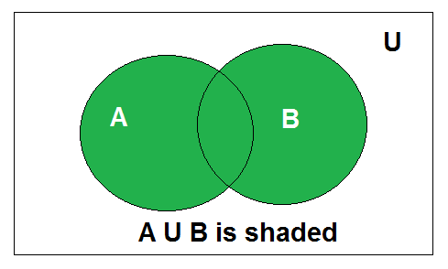
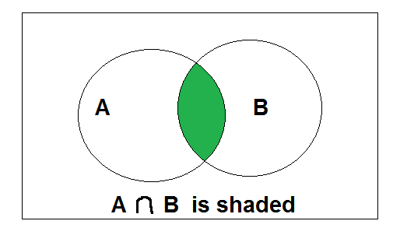
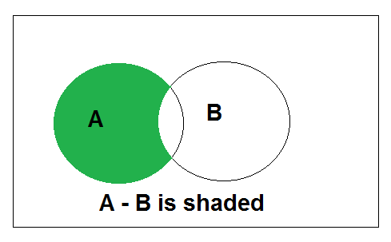
UNION, INTERSECT, EXCEPT
Set operations UNION(∪), INTERSECT(∩) and EXCEPT(-) are implemented in SQL
We can use Union, Intersect and Except only on Union Compatible relations.

Slide 6
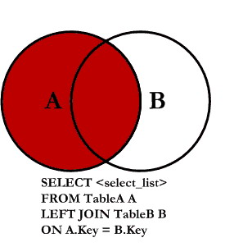
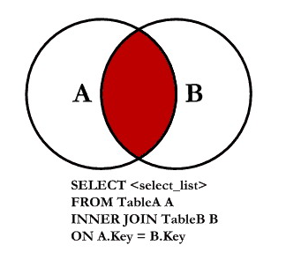
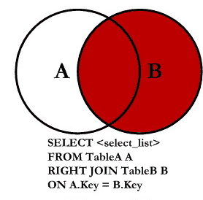
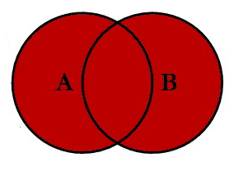
Joins
LEFT JOIN
LEFT JOIN
INNER JOIN
RIGHT JOIN
SELECT <select-list>
FROM table1
(INNER | LEFT | RIGHT | OUTER) JOIN table2
ON <columns-to-join>
FULL OUTER JOIN

Slide 7
Correlated Nested Queries
Find the names of sailors who have reserved boat number 103
SELECT S.sname
FROM Sailors S
WHERE EXISTS ( SELECT *
FROM Reserves R
WHERE R.bid = 103
AND R.sid = S.sid )
UNIQUE
false if two or more rows are returned
op ANY
op ALL

Slide 8
Declaring variables and Exceptions
EXEC SQL BEGIN DECLARE SECTION C
char c sname[20];
long c sid;
short c rating;
float c age;
EXEC SQL END DECLARE SECTION
EXEC SQL WHENEVER [ SQLERROR | NOT FOUND ] [ CONTINUE | GOTO stmt | BREAK | Do function ]
EXEC SQL INSERT INTO Sailors VALUES (:c sname, :c sid, :c rating, :c age);
-SQLCODE defined to return some negative value when an error condition Arises.
-SQLSTATE, introduced in the SQL-92 standard for the first time, associates predefined values with several common error conditions, thereby introducing some uniformity to how errors are reported.
One of these two variables must be declared.

Slide 9
Cursors
We use cursors to navigate through the SQL query’s output
DECLARE cursorname [INSENSITIVE] [SCROLL] CURSOR FOR
some query
[ ORDER BY order-item-list ]
[ FOR READ ONLY | FOR UPDATE ]
EXEC SQL WHENEVER NOT FOUND DO BREAK;
EXEC SQL DECLARE cursorName CURSOR FOR SELECT S.sname, S.rating FROM Sailors AS S;
EXEC SQL OPEN cursorName;
while (1) {
EXEC SQL FETCH cursorName INTO :c_sname, :c_rating;
}
EXEC SQL CLOSE myCursor;

Slide 10
ODBC and JDBC Architecture
Type I (bridges)
  Translates JDBC function calls into function calls of another API that is not native to the DBMS.
  The application loads only one driver, namely the bridge.
Type II (direct translation to the native API)
  Translates JDBC function calls directly into method invocations of the API of one specific data source.
  The driver is specific to the data source.
Type III (network bridges)
  The driver talks over a network to a middle-ware
  server that translates the JDBC requests into DBMS-specific method invocations.
  The driver on the client site is not DBMS specific.
Type IV (direct translation over sockets) I
  The driver communicates with the DBMS through Java sockets.
  The driver on the client side is DBMS-specific.

Slide 11
Domains, CHECK and Triggers
CREATE DOMAIN ratingval INTEGER DEFAULT 0
CHECK ( condition )
CREATE TRIGGER trigger_name ON table ( BEFORE | AFTER | INSTEAD OF ) ([ INSERT ] [ , ] [ UPDATE ] [ , ] [ DELETE ])
(WHEN condition)
(FOR EACH ROW) | FOR EACH STATEMENT
BEGIN | (SQL query)
{action} |
END |

